Slide 1
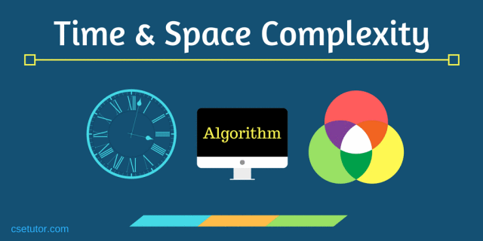
CSE214: Algorithms
Computational complexity
‹#›
Notes:
‹#›

Slide 2
Today’s Contents
How to find the Complexity of an Algorithm?
‹#›
Notes:
‹#›

Slide 3
Let’s Find out the complexity of Algorithms
‹#›
Notes:
‹#›

Slide 4
Find the Complexity of the following Algorithm
Example-1:
a = 4;
b = a + 7;
for i = 1 to n;
SUM = a+b ;
// This will be executed only once.
// This will be executed only once
// This will be executed n+1 times
// This will be executed n times
‹#›
Notes:
‹#›

Slide 5
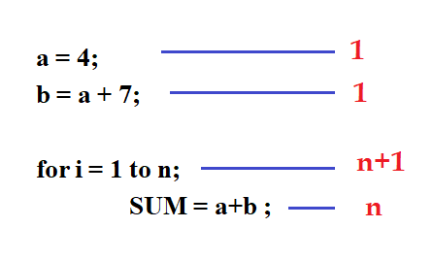
Find the Complexity of the following Algorithm
Example-1:
So the number of operations required by this loop are
T(n) = (1 + 1 + (n + 1) + n)
= 2n + 3
= O (n)
‹#›
Notes:
‹#›

Slide 6
Find the Complexity of the following Algorithm
Example-2:
for i = 1 to n
for j = 1 to n
SUM = a+b ;
-------------------- O (n)
-------------------- O (n)
So the number of operations required by this loop are
T(n) = O (n) * O (n)
= O (n²)
‹#›
Notes:
‹#›

Slide 7
Find the Complexity of the following Algorithm
Example-3:
Self Practice
for i = 1 to n
for j = 1 to n
for k = 1 to n SUM = a+b ;
‹#›
Notes:
‹#›

Slide 8
Find the Complexity of the following Algorithm
Example-4:
------------------ O (n)
---------------- O (n)
for i = 1 to n
\\ SUM = a+b ;
for j = 1 to n \\ SUM = a+b ;
So the number of operations required by this loop are
T(n) = O (n) + O (n)
= O (2n)
= O (n)
‹#›
Notes:
‹#›

Slide 9
Find the Complexity of the following Algorithm
Example-5:
for i = 1 to n
for j = 1 to 500 SUM = a + b ;
---------------------- O(n)
---------------------- O (1)
So the Time Complexity
T(n) = O(n) * O(1)
= O(n)
‹#›
Notes:
‹#›

Slide 10
Find the Complexity of the following Algorithm
Self Practice
Example-6:
Sum = 0
for i = 1 to n
SUM += A[i] ;
Print Sum
‹#›
Notes:
‹#›

Slide 11
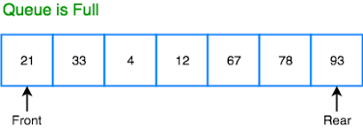
Find the Complexity of the following Algorithm
Self Practice
Example-6:
Sum = 0
for i = 1 to n
SUM += A[i] ;
Print Sum
‹#›
Notes:
‹#›

Slide 12
Find the Complexity of the following Algorithm
Example-7:
MAX = A[0]
for i = 1 to n
if A[i] > MAX
MAX = A[i] ;
Print MAX
------------------ 1
---------------- n + 1
---------------- n
---------------- C
---------------- 1
So the Time Complexity
T(n) = 1+ (n +1) + n + C + 1
= (2n + 3 + C)
‹#›
= O (n)
Notes:
‹#›

Slide 13
Find the Complexity of the following Algorithm
Example-8:
Self Practice
flag = FALSE
for i = 1 to n
if A[i] == key
flag = TRUE;
if flag == TRUE
FOUND
else
NOT FOUND
‹#›
Notes:
‹#›

Slide 14
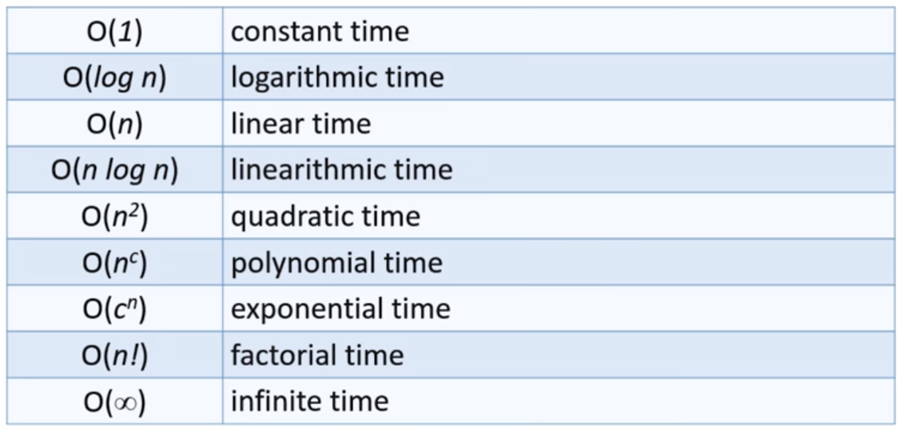
Some common rates of growth
Let n be the size of input to an algorithm, and k some constant. The following are common rates of growth.
‹#›
Notes:
‹#›

Slide 15
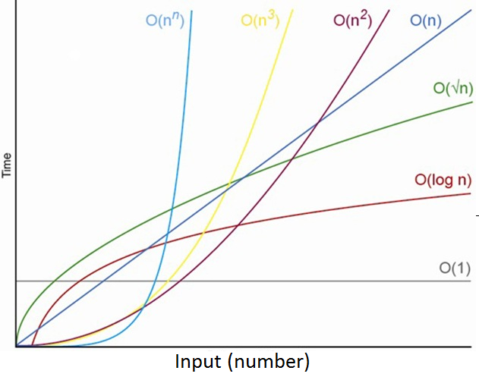
Rate of Growth
‹#›

Slide 16
Time complexity (Worst Case) of some data Structures
 | Time complexity (Worst Case)
 | Access | Search | Insertion | Deletion
Array | O(1) | O(n) | O(n) | O(n)
Singly Linked List | O(n) | O(n) | O(1) | O(1)
Stack | O(n) | O(n) | O(n) or O(1) | O(n) or O(1)
‹#›
Notes:
‹#›

Slide 17

Thank you!
‹#›

